Slide 1



Name of Project
Air Pollution Monitoring and Prediction using AI/ML
Name: Vishwa K
Internship ID : INTERNSHIP_17513641056863b20937d78

Slide 2

Learning Objectives
Understand the impact of air pollution on human health and
the environment.
Learn data preprocessing techniques for real-world datasets
Apply machine learning models for AQI prediction.
Develop EDA (Exploratory Data Analysis) skills with
visualizations.
Compare algorithms and identify the best-performing model.
Gain exposure to professional project workflow using
GitHub.
GOAL
Source :
www.freepik.com/

Slide 3
Tools and Technology used
Programming Language: Python
Libraries: Pandas, NumPy, Matplotlib, Seaborn, Scikit-learn
Development Platform: Jupyter Notebook
Version Control: Git & GitHub for repository management
Visualization Tools: Line charts, bar charts, heatmaps
Algorithms Used: Linear Regression, Decision Tree, Random Forest

Slide 4
Methodology
Data Collection – Kaggle Air Quality Dataset (2015–2020).
Data Preprocessing – Handling missing values, encoding, city filtering.
Exploratory Data Analysis (EDA) – AQI trends, averages, heatmaps.
Model Building – Linear Regression, Decision Tree, Random Forest.
Training & Testing – 80% training, 20% testing split.
Evaluation Metrics – MAE, RMSE, R² Score.
Insights & Interpretation – pollutant importance & AQI prediction.

Slide 5
Problem Statement:
Urbanization & industrialization have worsened air quality in India.
AQI levels are consistently above safe health standards in many cities.
Current monitoring systems only display data, without predictions.
Lack of forecasting prevents timely alerts and preventive actions.
High AQI directly impacts public health, climate, and economy.
Need for an AI/ML-based system to predict AQI and highlight key pollutants.

Slide 6
Solution:
Built an AI/ML pipeline for air quality monitoring.
Preprocessed dataset for 7 metro cities (Delhi, Mumbai, Chennai, Kolkata,
Bengaluru, Hyderabad, Ahmedabad).
Applied 3 machine learning models:
Linear Regression → baseline.
Decision Tree → non-linear insights.
Random Forest → best performance.
Identified PM2.5, PM10, NO₂ as critical pollutants.
Provided visualizations & insights to help policymakers and citizens.
GitHub Repository Link: https://github.com/Vinai10/Air-Pollution-Project-AI-ML

Slide 7
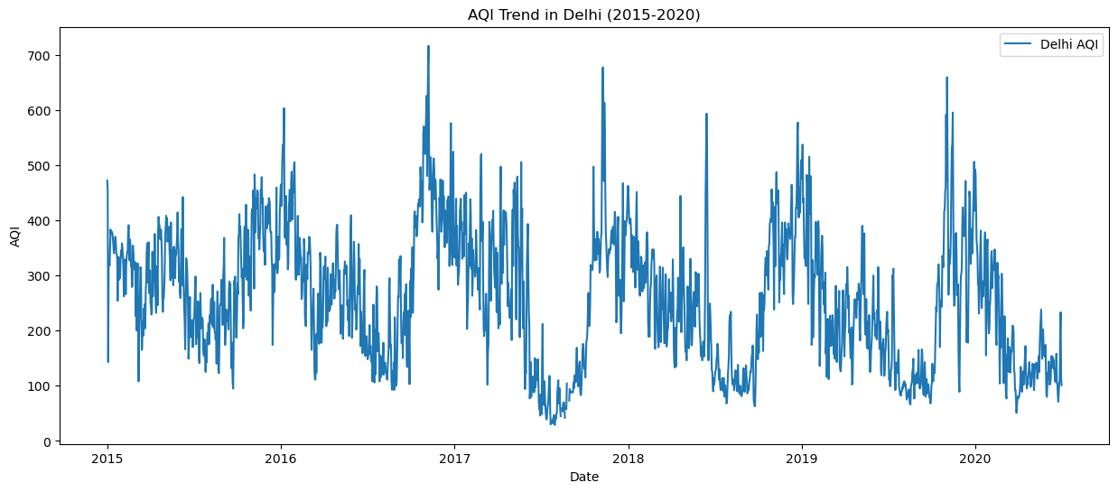
Exploratory Data Analysis 1:
Line plots showing AQI trends over time for Delhi & other cities.
Seasonal patterns observed in AQI levels.
Delhi recorded highest AQI fluctuations.
Cities like Chennai & Bengaluru showed relatively better air
quality.
Helps in understanding data patterns before applying ML models.

Slide 8
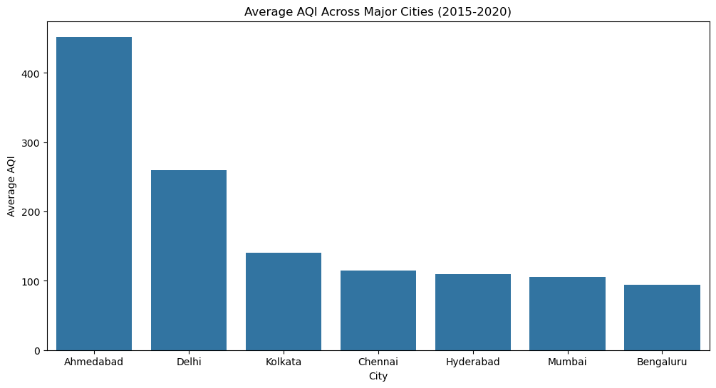
Exploratory Data Analysis 2:
Average AQI per city compared using bar charts.
Delhi consistently at the top of pollution index.
Mumbai, Kolkata, and Hyderabad show moderately high
AQI.
Bengaluru and Chennai show comparatively lower pollution
levels.
Highlights regional differences in air quality.

Slide 9
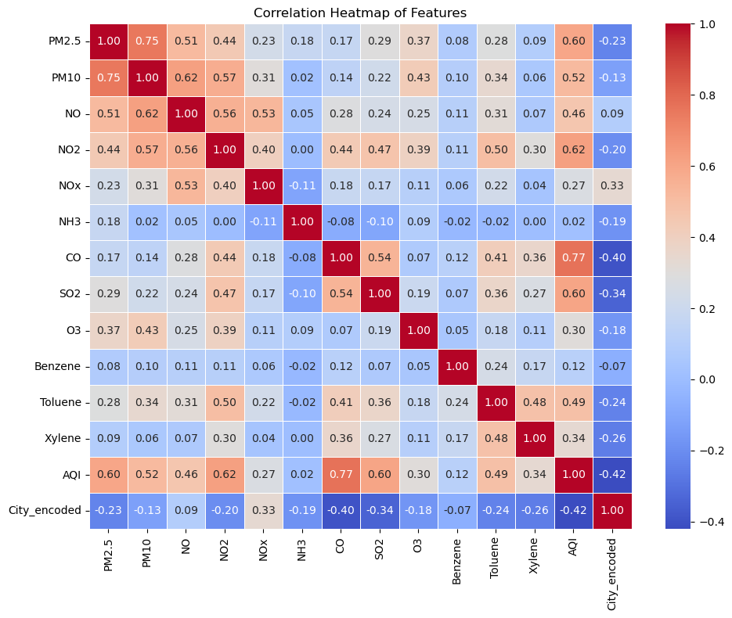
Exploratory Data Analysis 3:
Correlation heatmap generated for pollutants.
PM2.5 & PM10 strongly correlated with AQI levels.
NO₂ also significantly influences air pollution trends.
Ozone (O₃) showed weaker correlation.
Heatmap provides insight into feature selection for ML
models.

Slide 10
Model Building :
Implemented three regression models:
Linear Regression (baseline performance).
Decision Tree (captures non-linear relationships).
Random Forest (ensemble model for higher accuracy).
Train-Test Split: 80% training, 20% testing.
Models trained on pollutant data as features and AQI as target.
Hyperparameter tuning applied for better optimization.

Slide 11
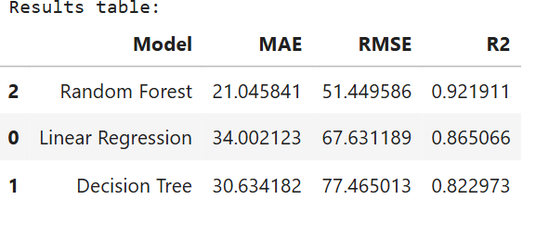
Model Evaluation :
Evaluation metrics used:
MAE (Mean Absolute Error) → average prediction error.
RMSE (Root Mean Squared Error) → penalizes large errors.
R² Score → measures goodness of fit.
Results show Random Forest achieved the highest accuracy.
Decision Tree moderately accurate, Linear Regression
performed weakest.

Slide 12
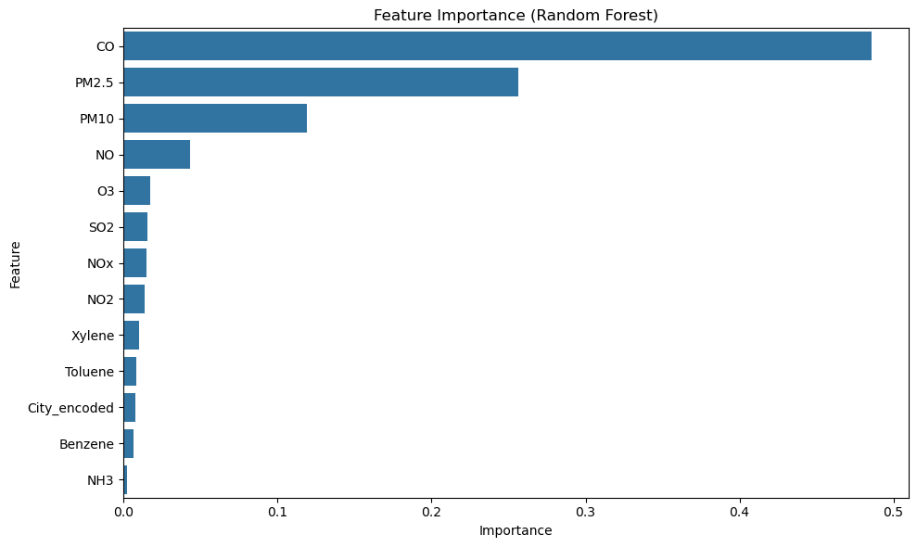
Result and Comparison :
Metrics Table comparing all 3 models (MAE, RMSE, R²).
Random Forest: best R² score with lowest errors.
Feature Importance (Random Forest):
PM2.5 → most critical pollutant.
PM10 → second most impactful.
NO₂ → significantly affects AQI.
Provided actionable insights for pollution control.

Slide 13
Screenshot of Output:

Slide 14
Conclusion:
Built a working ML model for AQI prediction.
Successfully handled data preprocessing, visualization, and
modeling.
Random Forest was the most effective model.
Identified PM2.5, PM10, NO₂ as major contributors.
Provided insights that can help governments, NGOs, and citizens.

